Slide 1
Data Center Infrastructure Management (DCIM)
Submitted By Pramila Dalavai
1BM18IS068
Submitted To Dr. Sheela S. V
(Associate Prof)

Slide 2
Problem Statement
A data center architecture is designed to provide an organization with certain types of resources. These include processing power, also called “compute” (CPU), storage (RAM and disk space), and networking connectivity.
While an organization can deploy all of these resources in an data center, these same resources are available for lease. Instead of purchasing and maintaining their own physical infrastructure, virtual data centers allow organizations to rent our virtual infrastructure from cloud providers at need.

Slide 3
Introduction
Data Center Infrastructure Management (DCIM) software is a new class of software that gives data center operators the ability to run efficient data center operations and improve data center infrastructure planning and design.
It typically replaces Excel, Visio, and home grown databases. DCIM software can bridge information across organizational domains – Data Center Ops, Facilities, and IT to maximize utilization of the data center.

Slide 4
Background
With DCIM -
Instantaneous visual and textual information on the equipment in the data center reduces troubleshooting time
Centralized database enables accurate record keeping and processes
Quickly model and allocate space for new servers, manage power and network connectivity in a single view or a few clicks
Without DCIM
Wasted capacity due to inability to understand cooling requirements
Spreadsheets or Homegrown tools
Need to physically go on site to determine space availability and position
Inaccurate and incomplete records
Information contained within multiple systems with no way to integrate the data

Slide 5
Tools Used
Backend - Python
Frontend - React
3D Visualization - Java and ODA library
Security - MFA and SSO
Database - Siebel
API - Sunbird

Slide 6
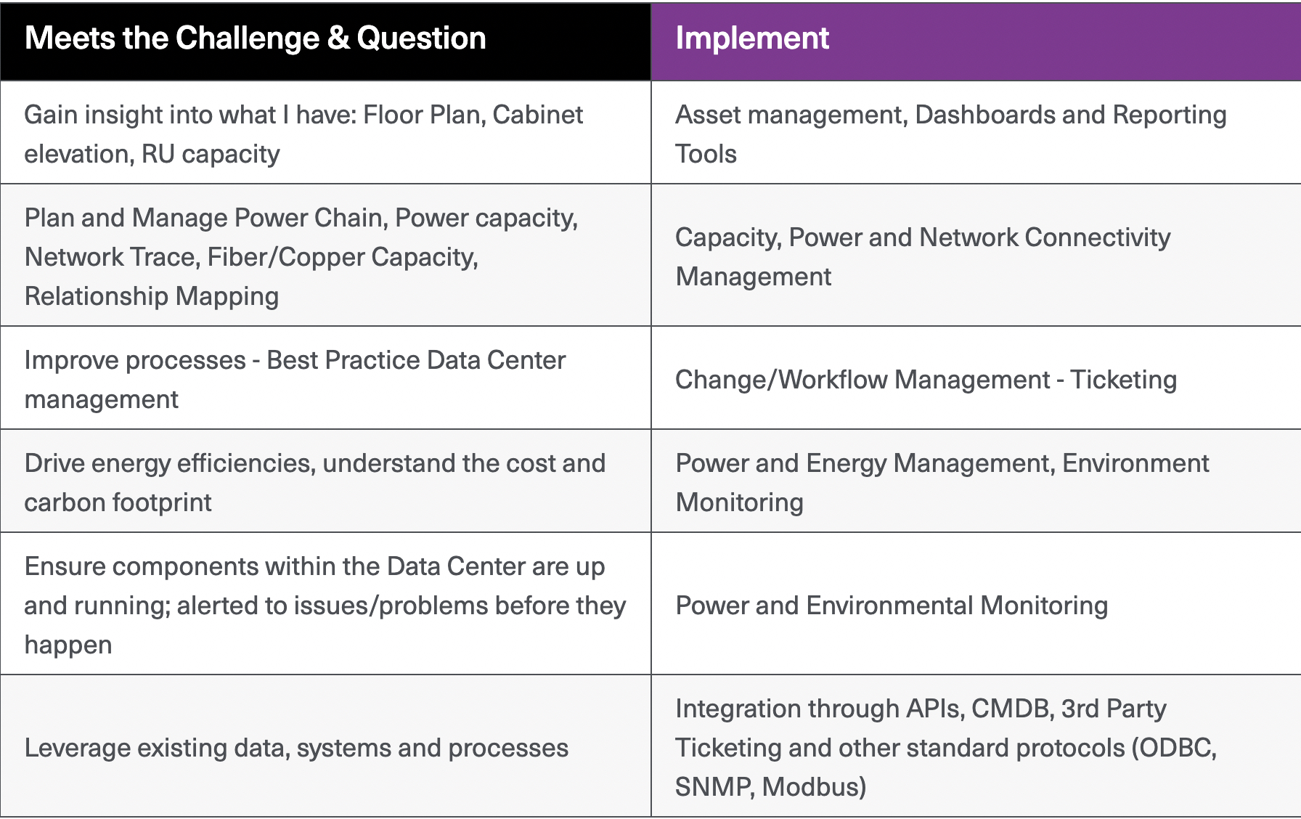
Methodology

Slide 7
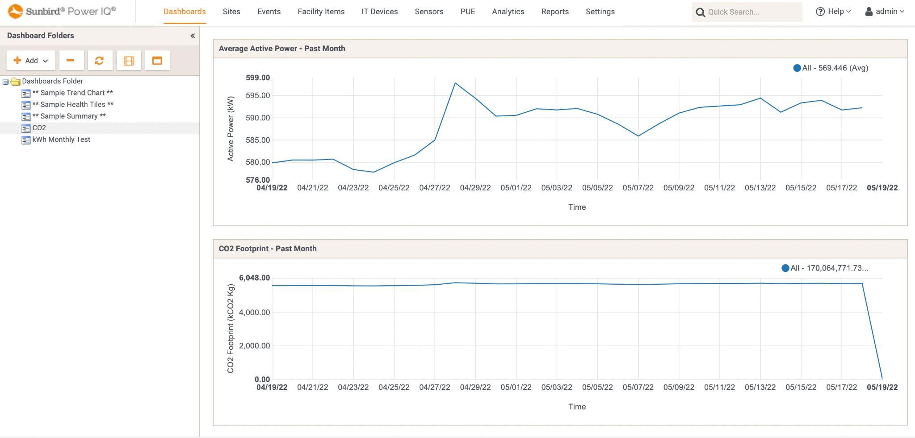
Results

Slide 8
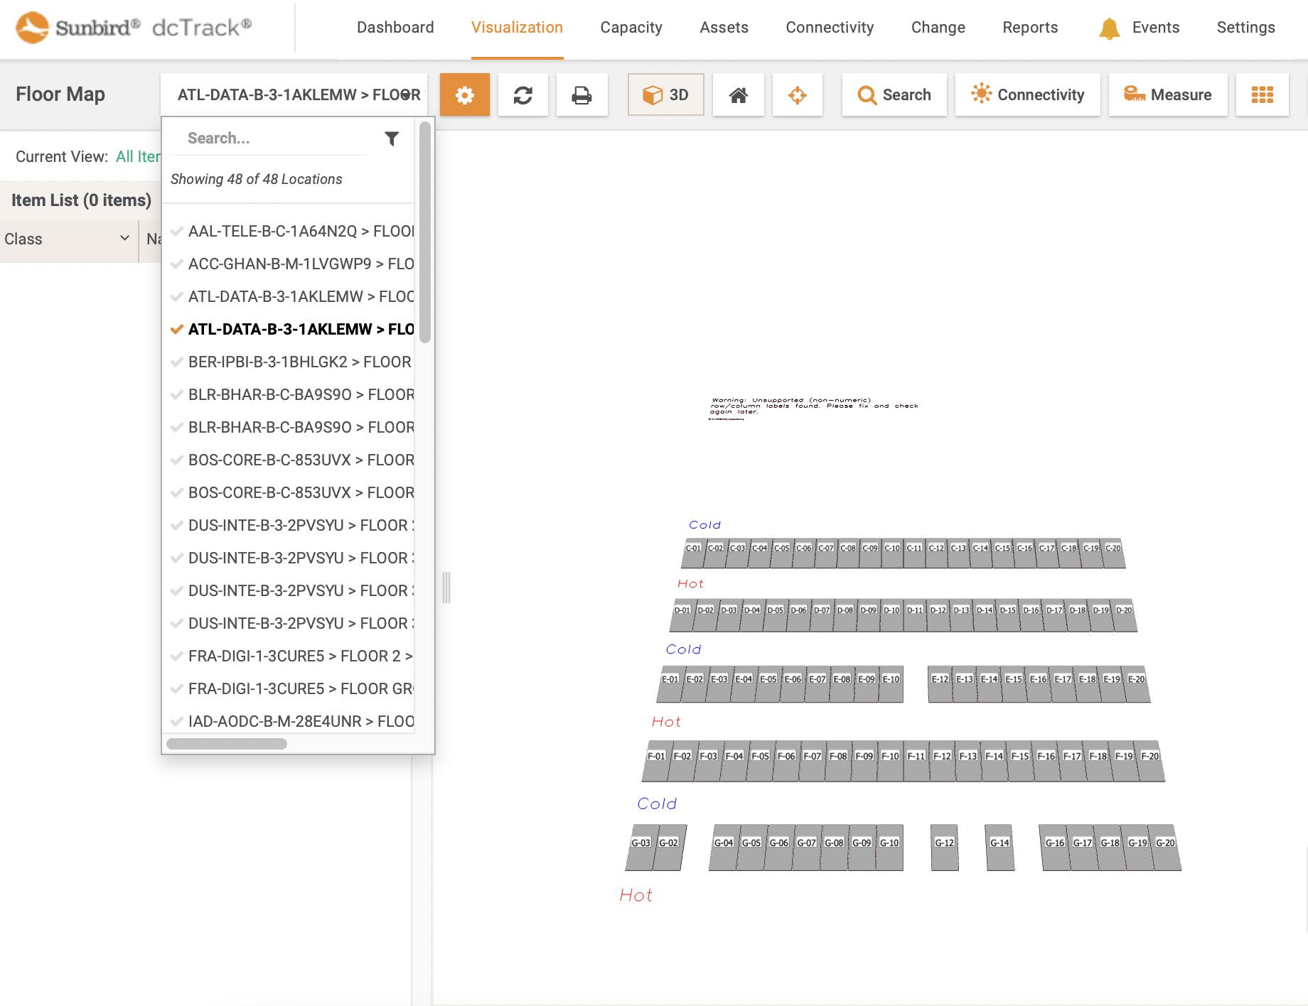

Slide 9
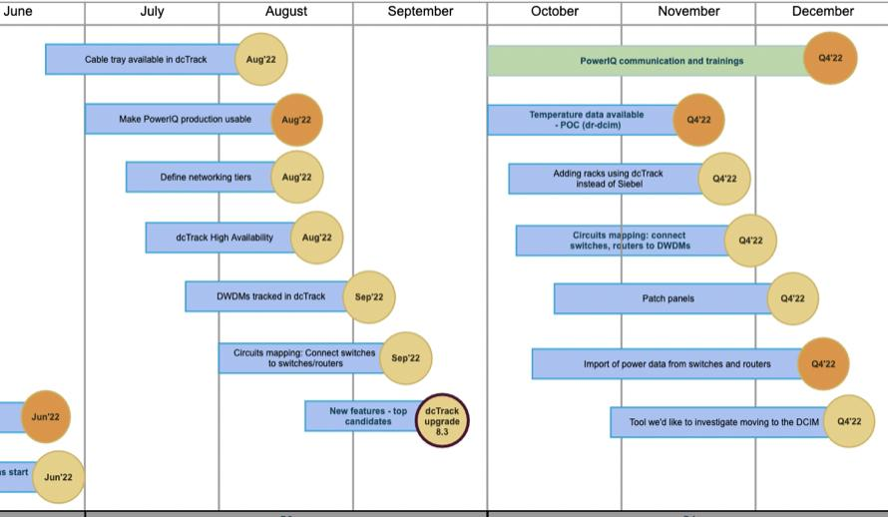
Future Scope

Slide 10
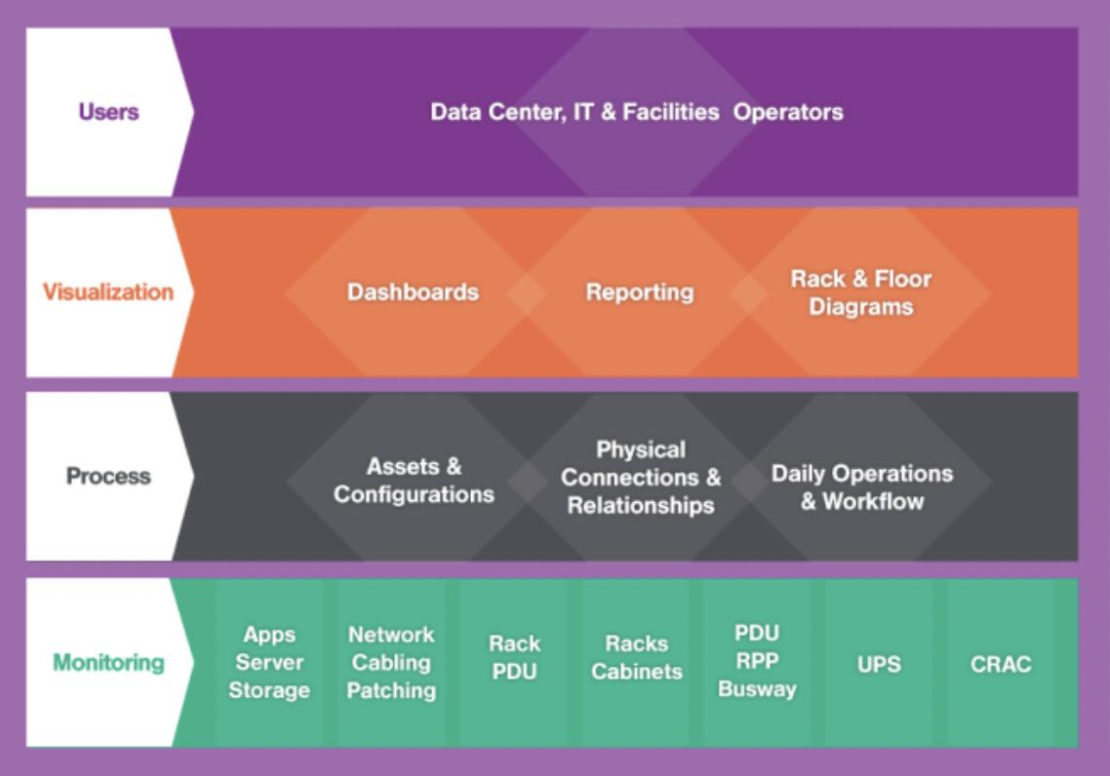
Conclusion
DCIM software provides data center operations managers with the ability to identify, locate, visualize, and manage all physical data center assets, quickly provision new equipment, and confidently plan capacity for future growth.
DCIM tools can also help control energy costs, improve data center design, and increase operational efficiency.

